Slide 1



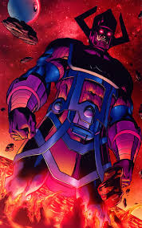
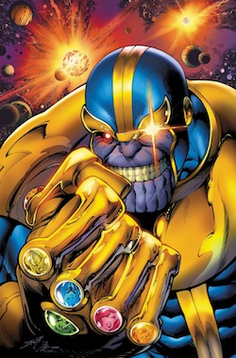
Integrated Comic Book Search & Recommendation Engine
Comi
X
Ne us

Slide 2
Agenda
Situation & Market Analysis
Vision & Implementation
Business Value

Slide 3
I. Situation & Market Analysis

Slide 4

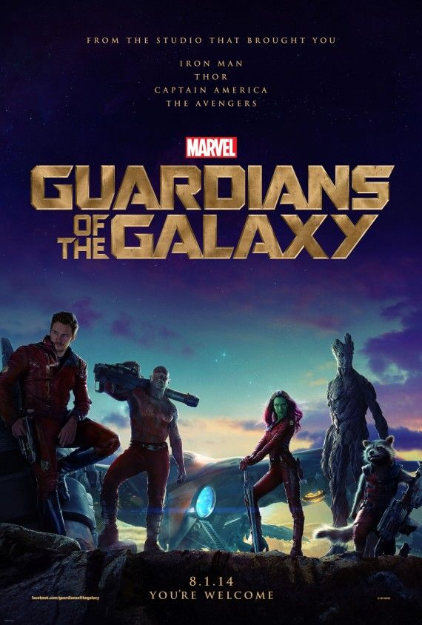
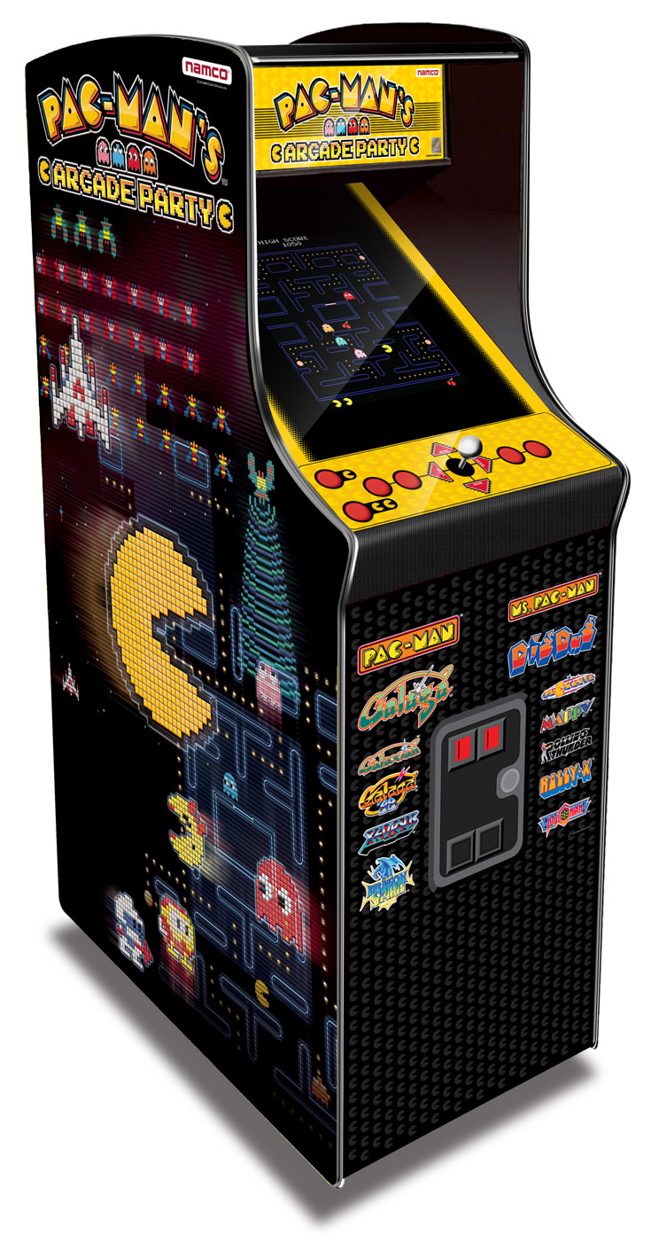
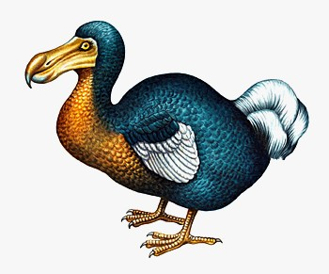
Situation Analysis
What do you do in your free time?
Who do these have in common?
Movies
Games
Dodo
Arcades
Comic Books
Situation Analysis
Strategic Change
Conclusion

Slide 5





Market Analysis
What’s the Problem?
Superman
Batman
Wonder Woman
Justice League
Typical Comic Store
Captain America
X-Men
Fantastic Four
Hulk
Wolverine
SUPER
HEROES 9000!
Buffy the Vampire Slayer
Avatar
Aliens
Predator
RoboCop
Saga
Situation Analysis
Strategy Change
Conclusion

Slide 6
II. Strategic Change

Slide 7



Business Strategy
Comic Book Search & Recommendation
Demand (Readers)
Supply (Writers/Authors)
Discover comics never seen before/non-mainstream
Rediscover historical grounding-breaking comic books from before you were born!
Enjoy niche genres/titles
20 Questions-5 recommendations
Support creator-owned (IP)
Encourage writers to earn a living wage
Resurgence of the innovative non-superhero narratives
Revival of comic books as a viable form of entertainment
Kabuki
Experimental
Artistic
Low on action
High on memories
Saga
Space opera/fantasy
Elopement during planet-wide war
Sci-fi Romeo & Juliet
Situation Analysis
Strategic Change
Conclusion

Slide 8

Recommendation Algorithms
What should prospective readers read?
Data Scraping
Data Analysis
Libraries
Scraped from reputable sites (ComicVine) for data: A beautiful soup of plot, title, author, publisher, genre/tags
Term Frequency-Inverse Document Frequency (TF-IDF) to parse our important words
Web-scraping:
bs4 (BeautifulSoup)
urllib2
Text Analysis:
nltk
sklearn
scipy
string
Visualization:
flask
matplotlib
OS helper libraries:
cPickle
random
os.path
Non-Negative Matrix Factorization (NMF)
Identity clusters and latent topics within corpus to make recommendations; homemade FP-growth technique
Cosine Similarity
Compares user input preferences to comic book documents to determine strength of similarity
KMeans
Unsupervised Intitial pass to identify clusters within the corpus
Situation Analysis
Strategic Change
Conclusion

Slide 9
III. Business Value & Conclusion

Slide 10



Market & Profitability
Ads
Geotargeted ads
Miscellaneous sponsors
Referrals
Embedded in Comixology for commission on referrals
Tie-ins
Blockbuster movies
AAA game titles
Situation Analysis
Strategic Change
Conclusion

Slide 11






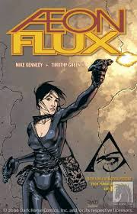


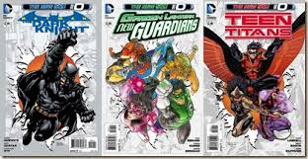
Implementation
Comi
X
Ne us
I’m feeling lucky
New 52!
Situation Analysis
Strategic Change
Conclusion

Slide 12


Conclusion
Comi
X
Ne us
Earth 616
Let’s build the future of comics NOW!
Goal: Popularize Watchmen; discover the next Walking Dead!
Situation Analysis
Strategic Change
Conclusion

